Slide 1
Description of a New Combined Classifier Proposal for Host-Based IDS
By Sattyik Kundu (#G00592624)

Slide 2
What is IDS?
IDS= Intrusion Detection System
Monitors network or system for malicious activity or policy violations including:
Denial of service attacks
Port scans
Malformed packets
Internet Protocol (IP) fragments
Restricted IP options and protocols
Internet Control Message Protocol (ICMP) redirect messages
Violations reported to administrator or collected centrally via SIEM(security information and event management) software/services.
IDS is Passive
IPS (intrusion prevention system) is active
Is categorized in few ways…….

Slide 3
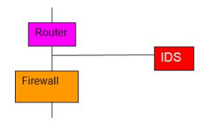
Network-Based IDS (NIDS)
NIDS work best when located on:
DMZ (subnet where external services face untrusted network)
subnets containing mission critical servers
Inside/outside the firewall.
Packet analysis of packets flowing through device
and matches against known library of attacks.
Detects:
DDoS attacks
Worms
Viruses
Malformed packets
NIDSs log their activities and report or alarm
on questionable events.

Slide 4
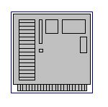
Host-Based IDS (HIDS)
Confined to monitoring on a single host.
Mainly used for detecting Internal Attacks.
Monitors:
Traffic from Network to Host
Local Objects(files, processes, services, OS, etc.)
Periodically examines system security logs for suspicious activity.

Slide 5
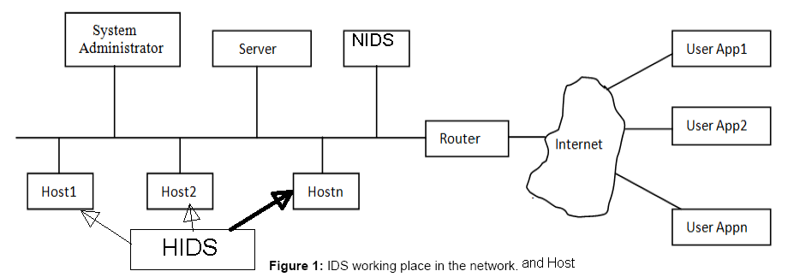
Network/Host Based IDS

Slide 6
Signature-Based Detection
Detects attacks by looking for specific data patterns like:
Byte sequences in network traffic
Instruction sequences from malware.
Compares data patterns to ‘signatures’ found in database
If traffic matches a signature → intrusion detected
Otherwise → no intrusion detected
Strengths:
Low false positive rates
Very effective against known attacks
Weaknesses:
Vulnerable to zero-day attacks –attacks NOT found in database
Vulnerable to variations of known threats and complex attacks with multiple elements
Signature-based IDS needs frequent patching

Slide 7
Anomaly-Based Detection
Uses an established baseline to determine if traffic/behavior is normal or anomalous
Mathematic models and Machine Learning used to create baseline.
Strengths:
Zero-day attacks can (theoretically) be avoided
Does not need frequent patching
Weaknesses:
High false positive rates
Intrusion activities that look similar to normal activities are harder to differentiate
Requires more overhead and processing power than signature-based detection

Slide 8
What is Machine-Based Learning(MBL)?
The ability of machines to learn without explicit programming.
Classifier – Algorithm that maps data into categories
receives data samples → recognize and discover data patterns
MBL Process in IDS systems:
IDS receives training data
Reduce training data into only ‘usable’ data for classifier
Ex: If only frequency was needed → use Fourier Transform to extract frequency values
Use reduced data to train the classifier
→result is a ‘baseline’ the IDS can use to determine intrusions
Use testing data to gauge usability of created model/baseline
Calibrate created the baseline as needed

Slide 9
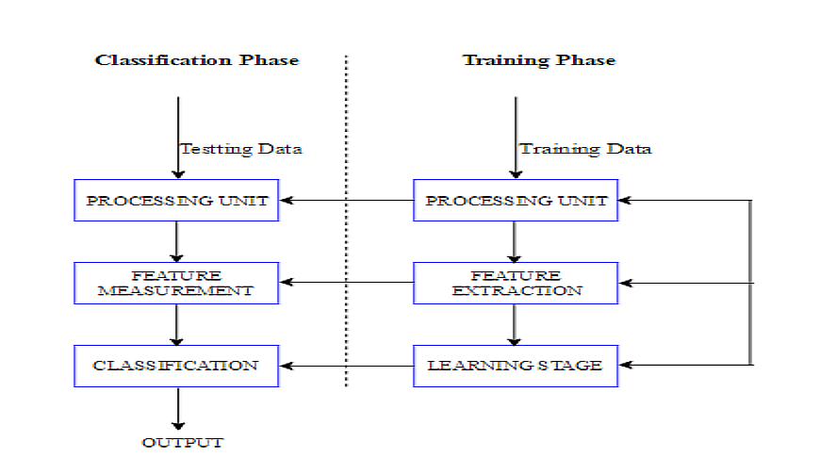
Machine Learning: Pattern Classification Process
#1
#2
Training Data
Testing Data

Slide 10
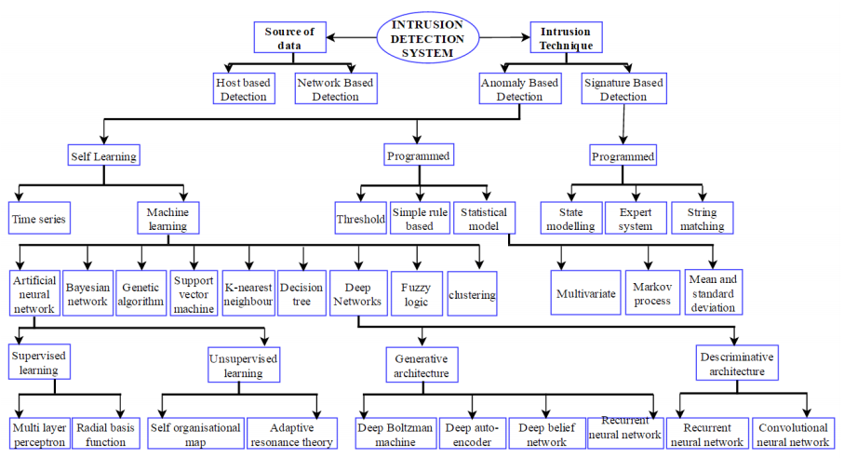
Graphical View – IDS w/respect to Machine Learning

Slide 11
Proposed Combined Classifier Implementation
GOAL: Propose an outline to create a Combined Classifier (a combination of classifiers) for more accuracy
Using: MLP-NN, Random Forest, and Naïve-Bayes Classifiers
Analogy: Diagnosis based on multiple doctors’ majority vote
Data: ADFA-LD or ADFA-WD for Training/Testing, KDD-99 experimental

Slide 12
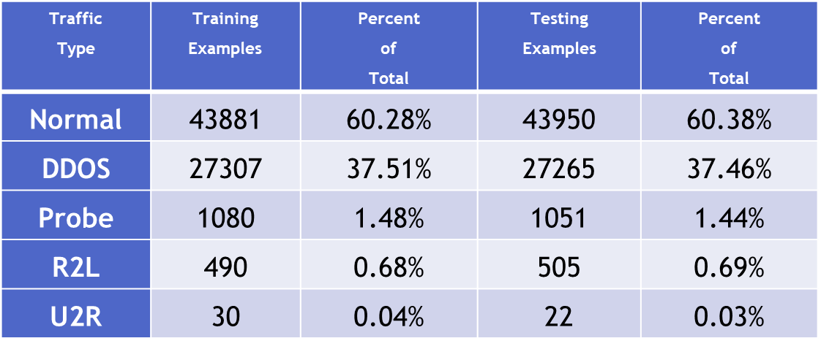
Data for Training and Testing: KDD-99
Back in 1998 and 1999, it was the 1st dataset to be publicly released for IDS testing.
Relative to actual network traffic, has a disproportionate amount of normal traffic and DDOS examples, as compared to the other attack types, Probing, User to Root (U2R) and Remote to Local (R2L)
However, it is out of date due to natural aging:
IDS and computing Architecture has changed since 1998,99.
Attack methods have greatly changed since then
The OS used was Solaris
Attacks and Normal data was too distinct→ didn’t make for effective testing of system robustness.
KDD-99 can still be used for initial testing.
ADFA-LD(or ADFA-WD) have superseded KDD-99

Slide 13
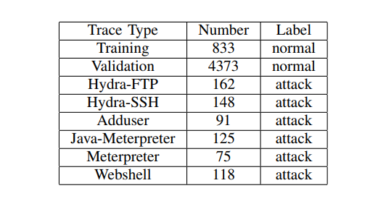
Data for Training and Testing: ADFA-LD
ADFA-LD Data: A collection of system call traces; each call trace collected during normal operation of host (Ubuntu Linux 11.04) containing Apache 2.2.17 running :
PHP 5.3.5,
FTP
SSH
MySQL 14.14,
and TikiWiki
Activities range from web browsing to LaTeX document preparation.
Each trace contains the system calls of a single process in the order in which the kernel received them
Traces were generated using audited Unix program and filtered by size. The size of the:
training data traces = [300 Bytes–6kB] each
validation traces = [300 Bytes–10 kB] each.
Table I: Attack Structure
Payload/Effect | Vector
Password bruteforce | FTP by Hydra THC
Password bruteforce | SSH by Hydra THC
Add new superuser | Client-side poisoned executable
Java Based Meterpreter | Tiki Wiki vulnerability exploit
Linux Meterpreter Payload | Client-side poisoned executable
C100 Webshell | PHP Remote File Inclusion vulnerability

Slide 14
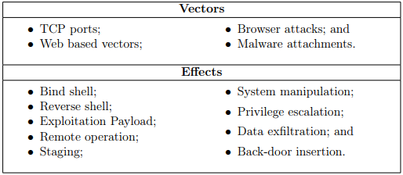
Data for Training and Testing: ADFA-WD
ADFA-WD dataset collected on an XP SP2 OS with:
An Active stateless firewall
Norton 2013 Anti-Virus
FTP server
Web server and management tool
Streaming audio digital radio package
Wireless and Ethernet network connectivity
ADFA-WD traces do not consist of system calls because of DLL (dynamic linked library) which complicates the interaction between programs and kernel whilst simplifying other aspects of the software engineering cycle.
Uses DLL access requests instead of system calls for traces
Notes:
On the other hand, Windows OS distributions make extensive use of DLL (dynamic linked library) which complicates the interaction between programs and kernel whilst simplifying other aspects of the software engineering cycle.
The DLL centric architecture of Windows means that system calls are often accessible through multiple paths with the result that decisions on normalcy cannot be made based on the system call patterns alone

Slide 15
Naïve Bayes Classifier
Algorithm Predicts a class’s value based on a set of given features
Treats class features as independent of each other.
Biased in favor of class values whose attributes are greater represented in training data
Ex:
If input class features are sweet and yellow:
P(Banana) = (200/650)*(450/800)*(450/1000) = 0.0779
P(Orange) = (250/650)*(300/800)*(350/1000) = 0.0505
P(Other) = (200/650)*(50/800) *(200/1000) = 0.0038
Fruit | Long | Sweet | Yellow | Total
Banana | 400 | 200 | 450 | 450
Orange | 0 | 250 | 300 | 350
Other | 100 | 200 | 50 | 200
Total | 500 | 650 | 800 | 1000
Highest probability that
the input’s class is a Banana.

Slide 16
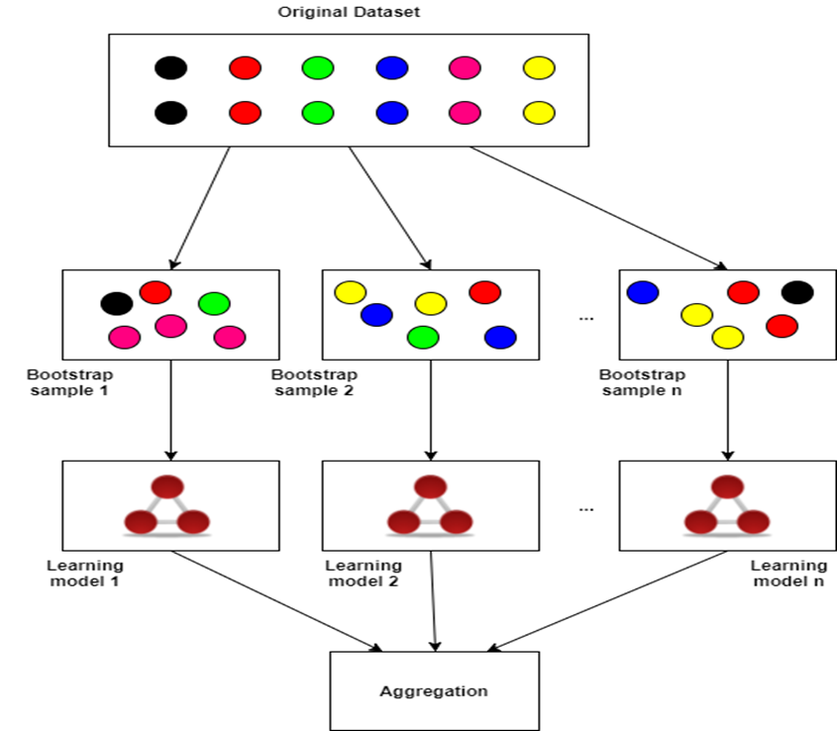
Random Forest
Is an ensemble classifier that consists of many decision trees and outputs the class that is the mode of the class's output by individual trees.
Random subsets(w/replacement) are used to create decision trees.
Decision trees are used to determine class of input variable
Strengths:
Runs efficiently over large datasets
Handle thousands of inputs without variable deletion
Very Robust- maintains accuracy even when a large proportion of the data is missing.
Weaknesses:
Increasing correlation increases forest error rate

Slide 17
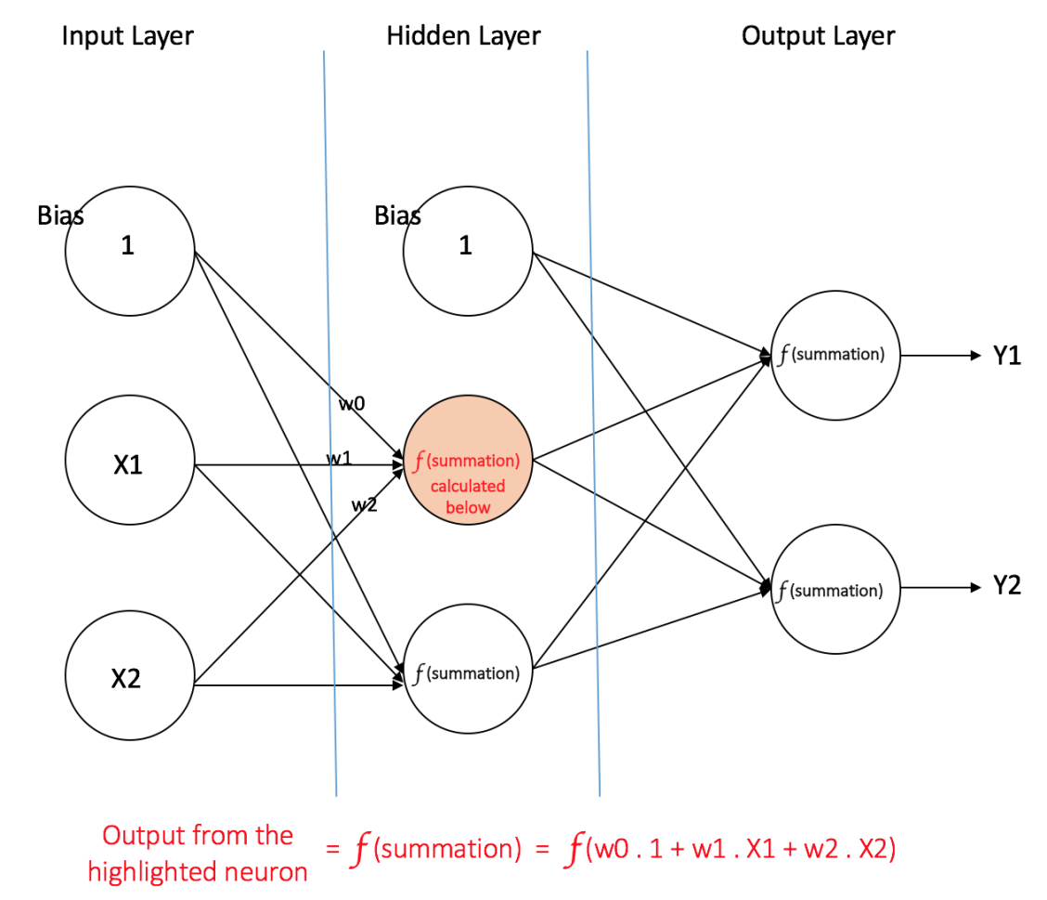
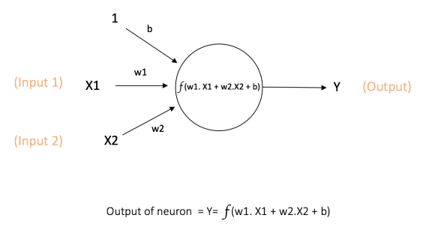
Multi-layer Perceptron (MLP-NN) With One Hidden Layer
MLP-NN and a Computation at One Neuron, f is a nonlinear function (usually sigmoidal), Trained by Back-Propagation Algorithm

Slide 18
More on MLP-NN
A MLP-NN neural network can consist of three types of nodes:
Input Nodes –Input nodes provide information from outside to network-- referred to as “Input Layer”. No computation is performed.
Hidden Nodes –Hidden nodes have no direct connection with outside world (hence “hidden”), perform computations and transfer information from input nodes to output nodes or next layer of hidden nodes --collection of hidden nodes forms a “Hidden Layer”. Output Nodes -Output nodes collectively referred to as “Output Layer” and transfers information to outside world.
Trained by Back-Prop: Errors computed at output nodes (expected value – computed value) propagated back to update weights of all layers -input layer to first hidden layer, hidden layer to hidden layer if more than 1 hidden layer, and last hidden layer to output layer.

Slide 19
More on Combined Classifier Implementation
Combination Scheme for Continuous Monitoring: Propose a simple combination scheme; could change after experimentation.
Number of classes: 2 (Attack vs. Non-Attack):
AP = Attack probability (or likelihood) from a classifier (0—1 given by Weka)
NP = Normal probability (or likelihood) from a classifier (0—1 given by Weka)
Combination Scheme Steps for each monitored data byte:
If Naïve Bayes has higher probability for attack compared to its normal probability:
Attack probability = 0.8 *(AP of Naïve Bayes) + 0.1*(AP of Random Forest) + 0.1*(AP of Neural Network)
Normal probability = 0.2 *(NP of Naïve Bayes) + 0.4*(NP of Random Forest) + 0.4*(NP of Neural Network)
Else:
Attack probability = 0.5 * (AP of Random Forest) + 0.5*(AP of Neural Network)
Normal probability = 0.1 * (NP of Naïve Bayes) + 0.45* (NP of Random Forest) + 0.45* (NP of Neural Network)
Decision:
If (Attack probability > Normal probability) → Attack is discovered
Else → No Attack is found
Notes:
Note: because of much larger number of exemplars (1 piece training/testing data) representing normal behavior, Bayes favors normal attack.
Feature Extraction: Will follow guidelines given in [Greech paper] for ADFA dataset, ADFA data set is labeled, use cross validation (next slide) to train and test each classifier. This stage is highly experiment dependent.

Slide 20
Metrics for Reporting
Classification Metrics: Classification metrics and implementation mode (10 folds cross-validation)
FP – False Positive, FN – False Negative
TP- True Positive, TN – True Negative
Precision: exactness – what % of exemplars that classifier labeled as positive are actually positive
Precision= TP/(TP+FP)
Recall: completeness – what % of positive exemplars did classifier label as positive?
Recall = TP/(TP+FN)
Perfect score is 1.0. Inverse relationship between precision & recall
Accuracy = Overall Correctness in classification
Accuracy= (TP+TN)/(TP+FP+TN+FN)
Cross-validation (k-fold, where k = 10 is most popular
Randomly partition the data into k substantially different subsets, each approximately equal size
At i-th iteration, use D_{i} as test set and others as training set
Notes:
exemplars (1 piece training/testing data)

Slide 21
WEKA Software
Weka - collection of publicly available free machine learning algorithms for data mining tasks, very POWERFUL
Algorithms applied directly to a dataset or called from Java code (suitable for Linux).
Tools for data pre-processing, feature evaluation, classification, regression, clustering, association rules, and visualization.
Handles missing data
Handles combination of many data types, such as numeric, strings etc. as features.
Input feature vector of each class presented using a specific format called ‘arff’ format
plan to use Weka software; used by researchers all over with great performances.

Slide 22
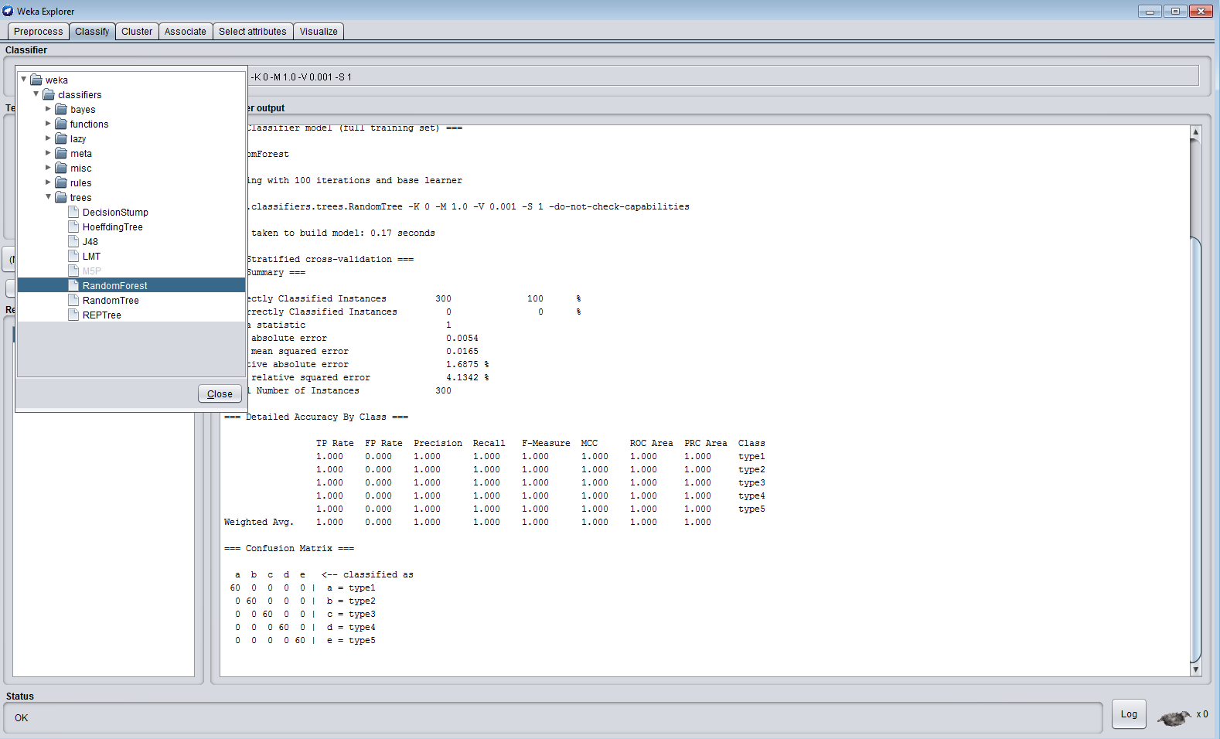
WEKA Screen Shot: Classification of a Simple 5-class Problem (RF)

Slide 23
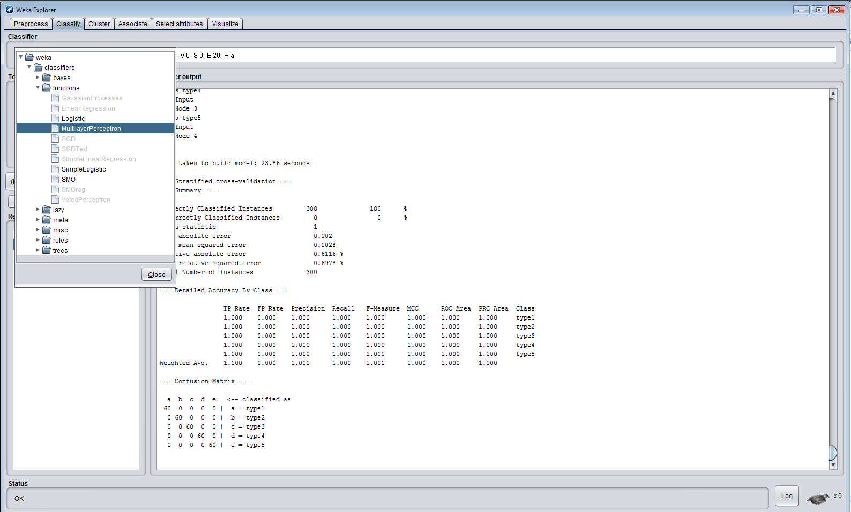
WEKA Screen Shot: Classification of a Simple 5-class Problem (MLP-NN)

Slide 24
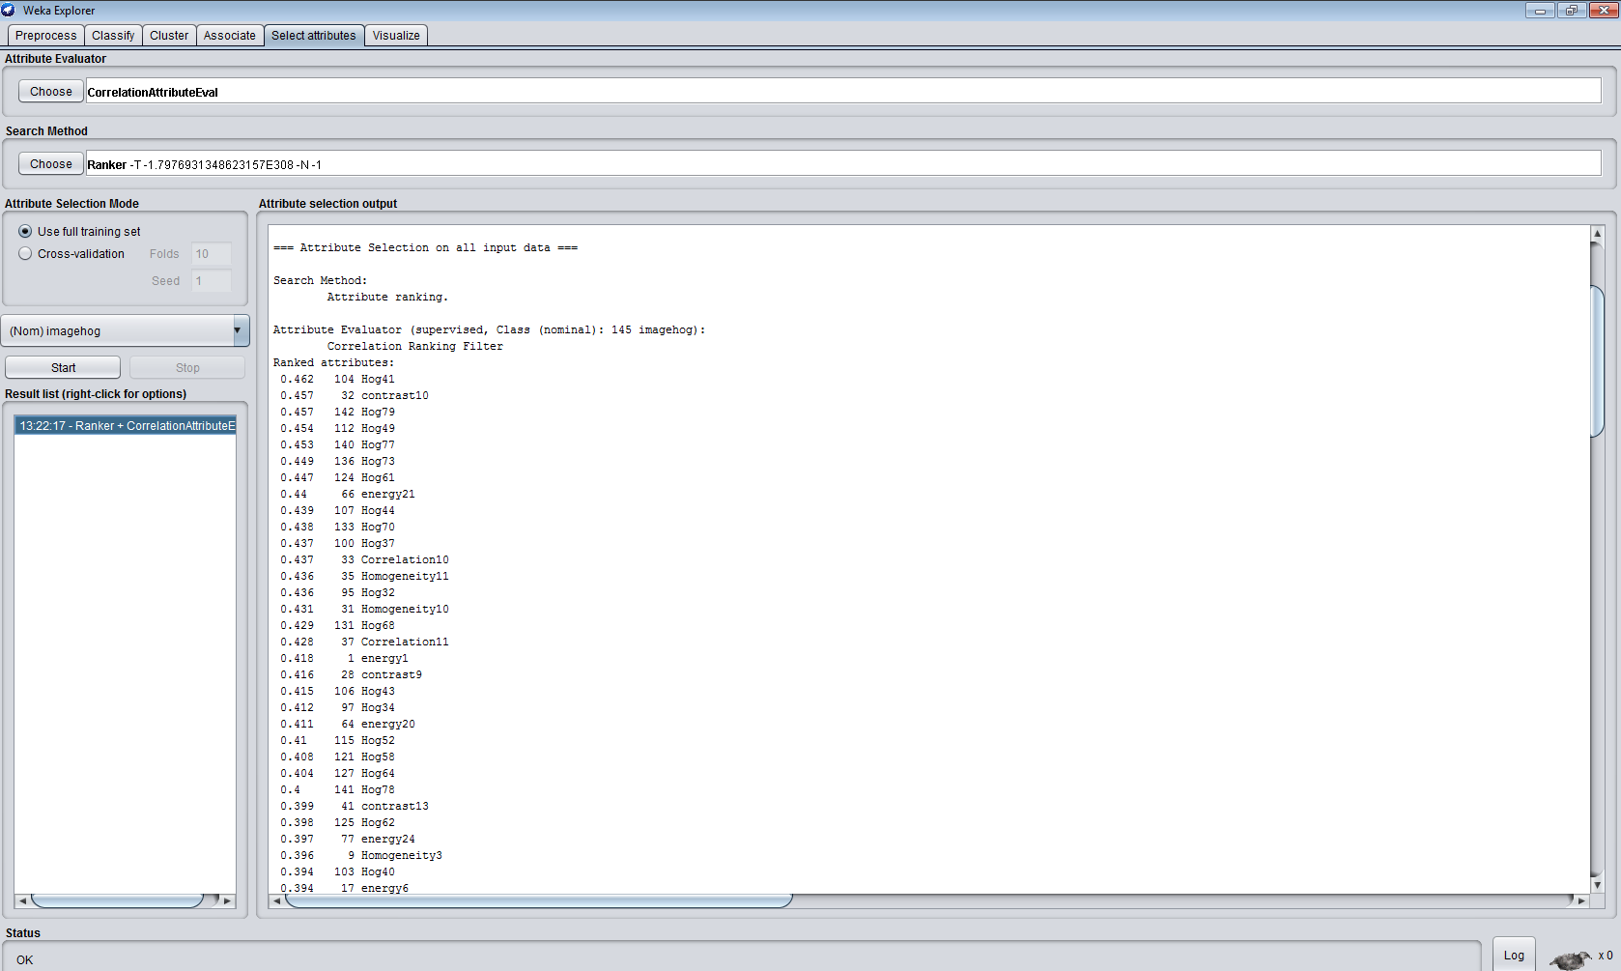
WEKA ranks features for selecting important features (from 140 features with name)

Slide 25
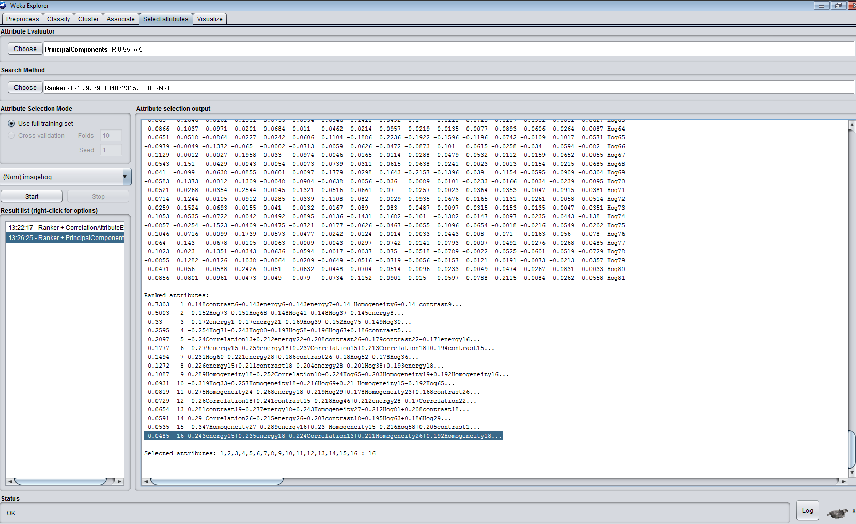
WEKA: Using Principal Components for Reduced Feature Set

Slide 26
Summarization
Surveyed many papers on HIDS and NIDS that use machine learning.
surveyed publicly available database for implementing any new machine learning scheme for HIDS.
Concluded that AFDA-LD data base is our optimal choice though KDD-99 may help us with training and gaining insights.
Proposed to use WEKA publicly available machine learning software to implement combined classifier scheme.
The 3 chosen classifiers are Radom Forest, MLP-NN and Naïve Bayes to implement combined classification scheme.
Outlined a preliminary combination scheme utilizing evidence from each
Optimistic that the proposed scheme is sound and will bear fruits.

Slide 27
The End

